Slide 1
Javascript
By-Aniket Artani
Notes:
¨a lightweight programming language ("scripting language")
¤used to make web pages interactive
¤insert dynamic text into HTML (ex: user name)
¤react to events (ex: page load user click)
¤get information about a user's computer (ex: browser type)
¤perform calculations on user's computer (ex: form validation)

Slide 2
In September 1995, a Netscape programmer named Brandan Eich developed a new scripting language in just 10 days. It was originally named Mocha, but quickly became known as LiveScript and, later, JavaScript.
The History of JavaScript

Slide 3

Are you also confused between JAVA and JavaScript?
There’s often some confusion about the two, but JavaScript and Java have almost nothing in common. The name JavaScript came from Netscape’s support of Java applets within its browser. Many say it was also a marketing tactic to divert some attention from Java, which was the most buzzed-about language at the time.
Notes:
To run Java programs, the code must be first compiled into an executable form. On the other hand, JavaScript was created to be interpreted at run time, making it much more dynamic (these days the boundary of the two methods is a lot more blurred).

Slide 4
One action, or method, that is built into the console object is the .log() method. When we write console.log() what we put inside the parentheses will get printed, or logged, to the console.
Console
It’s going to be very useful for us to print values to the console, so we can see the work that we’re doing.
Notes:
The console is a panel that displays important messages, like errors, for developers. Much of the work the computer does with our code is invisible to us by default. If we want to see things appear on our screen, we can print, or log, to our console directly.

Slide 5
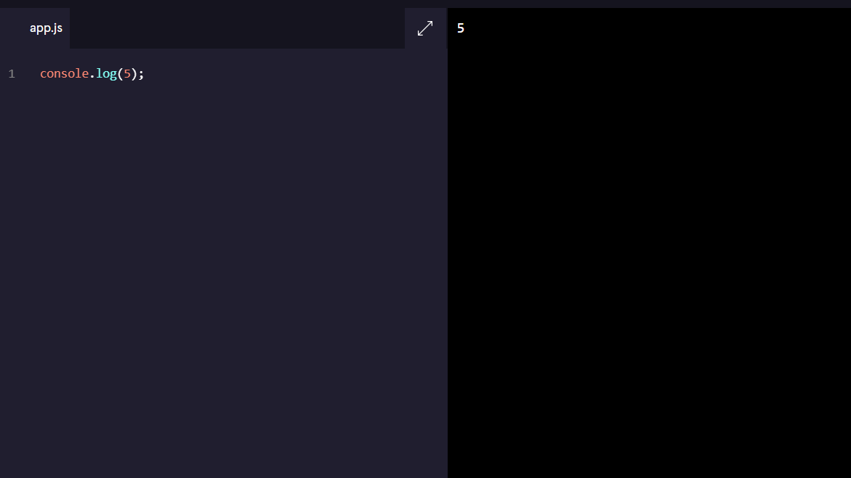

Slide 6

Comments
As we write JavaScript, we can write comments in our code that the computer will ignore as our program runs. These comments exist just for human readers.dd text
Notes:
Programming is often highly collaborative. In addition, our own code can quickly become difficult to understand when we return to it— sometimes only an hour later! For these reasons, it’s often useful to leave notes in our code for other developers or ourselves.
Comments can explain what the code is doing, leave instructions for developers using the code, or add any other useful annotations.

Slide 7
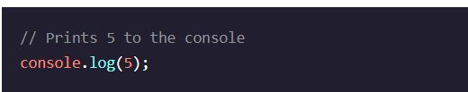
A single line comment will comment out a single line and is denoted with two forward slashes // preceding it.

Slide 8
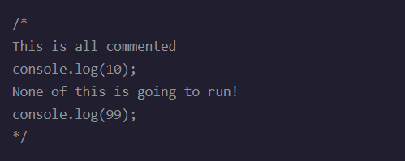
A multi-line comment will comment out multiple lines and is denoted with /* to begin the comment, and */ to end the comment.

Slide 9
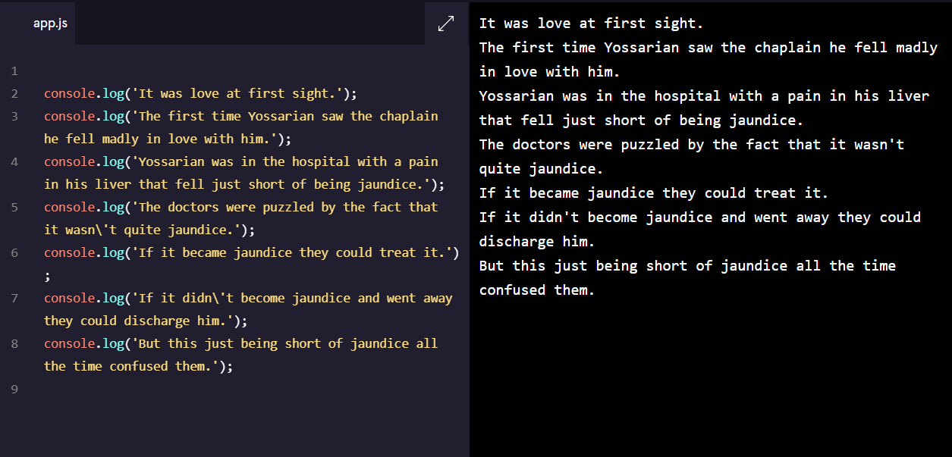

Slide 10
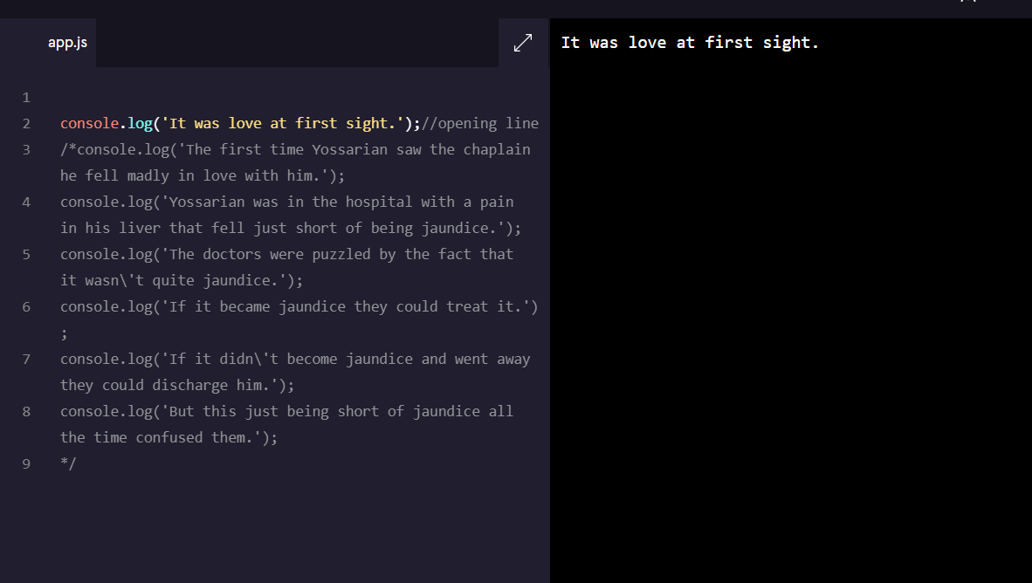

Slide 11
DATA TYPES
Number:.
String:
Boolean:
Null:
Undefined:
Notes:
Data types are the classifications we give to the different kinds of data that we use in programming
Number: Any number, including numbers with decimals: 4, 8, 1516, 23.42.
String: Any grouping of characters on your keyboard (letters, numbers, spaces, symbols, etc.) surrounded by single quotes: ' ... ' or double quotes " ... ". Though we prefer single quotes. Some people like to think of string as a fancy word for text.
Boolean: This data type only has two possible values— either true or false (without quotes). It’s helpful to think of booleans as on and off switches or as the answers to a “yes” or “no” question.
Null: This data type represents the intentional absence of a value, and is represented by the keyword null (without quotes).
Undefined: This data type is denoted by the keyword undefined (without quotes). It also represents the absence of a value though it has a different use than null.

Slide 12
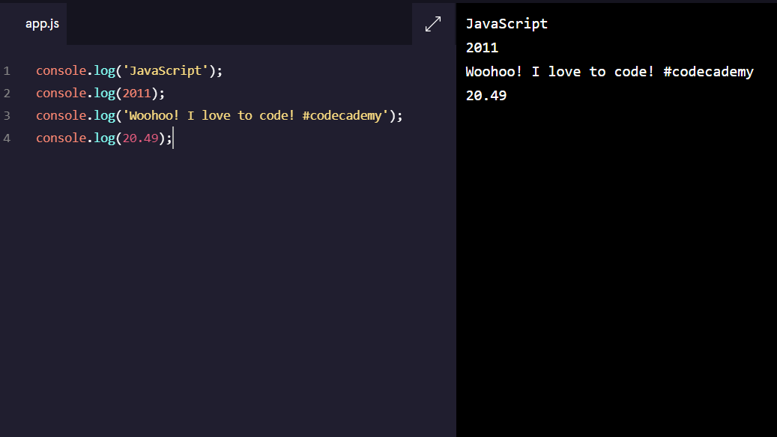

Slide 13

Arithmetic Operators
Add: +
Subtract: -
Multiply: *
Divide: /
Remainder: %
Notes:
An operator is a character that performs a task in our code. JavaScript has several built-in arithmetic operators, that allow us to perform mathematical calculations on numbers.These include the following operators and their corresponding symbols:

Slide 14
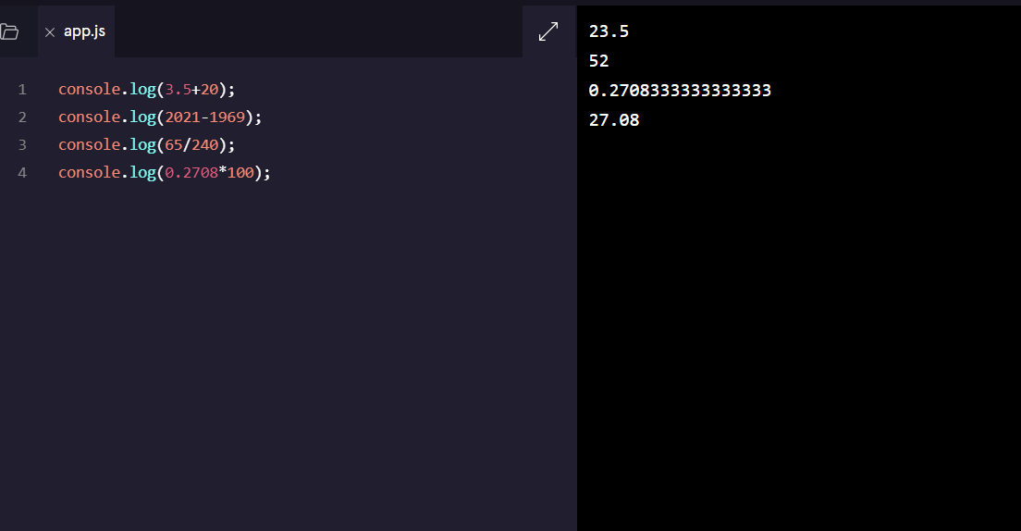

Slide 15

String Concatenation
Operators aren’t just for numbers! When a + operator is used on two strings, it appends the right string to the left string:
Notes:
This process of appending one string to another is called concatenation

Slide 16

Properties
Every string instance has a property called length that stores the number of characters in that string.
Notes:
When you introduce a new piece of data into a JavaScript program, the browser saves it as an instance of the data type. Every string instance has a property called length that stores the number of characters in that string. You can retrieve property information by appending the string with a period and the property name:

Slide 17
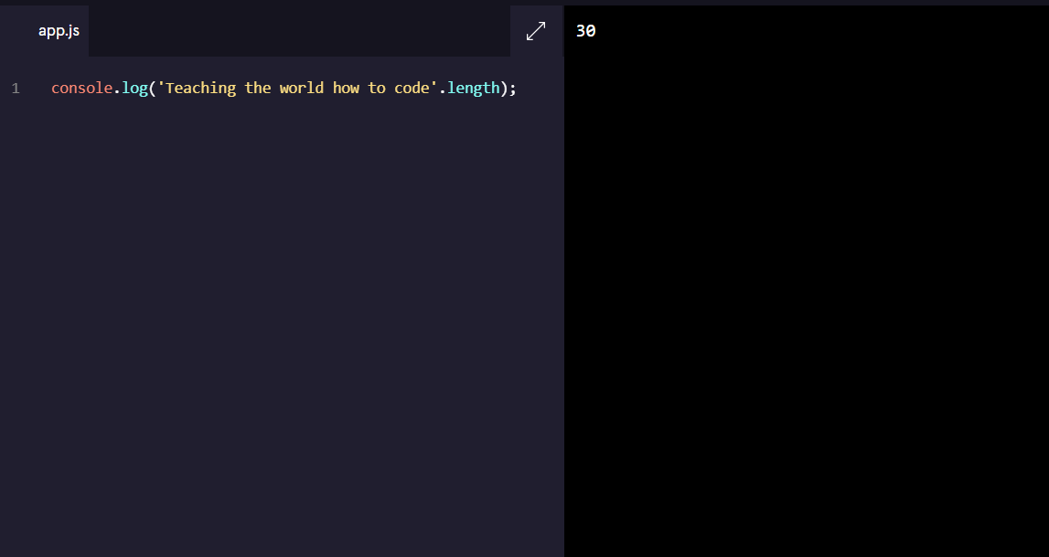

Slide 18
Methods
Remember that methods are actions we can perform. JavaScript provides a number of string methods.
We call, or use, these methods by appending an instance with:
a period (the dot operator)
the name of the method
opening and closing parentheses
'example string'.methodName()

Slide 19
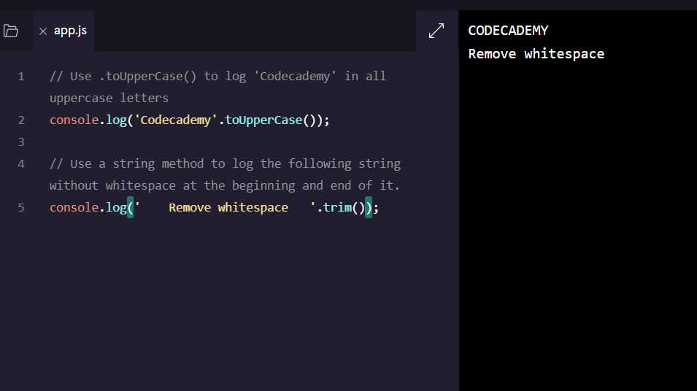

Slide 20
In addition to console, there are other objects built into JavaScript. Down the line, you’ll build your own objects, but for now these “built-in” objects are full of useful functionality.
Built-in Objects
Notes:
For example, if you wanted to perform more complex mathematical operations than arithmetic, JavaScript has the built-in Math object.

Slide 21

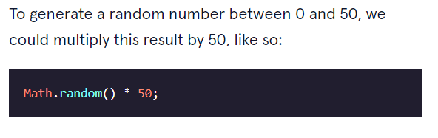

Slide 22

Math.floor() takes a decimal number, and rounds down to the nearest whole number. You can use Math.floor() to round down a random number like this:
Notes:
The example above will likely evaluate to a decimal. To ensure the answer is a whole number, we can take advantage of another useful Math method called Math.floor().
After ppt-
In this case:
Math.random generates a random number between 0 and 1.
We then multiply that number by 50, so now we have a number between 0 and 50.
Then, Math.floor() rounds the number down to the nearest whole number.

Slide 23
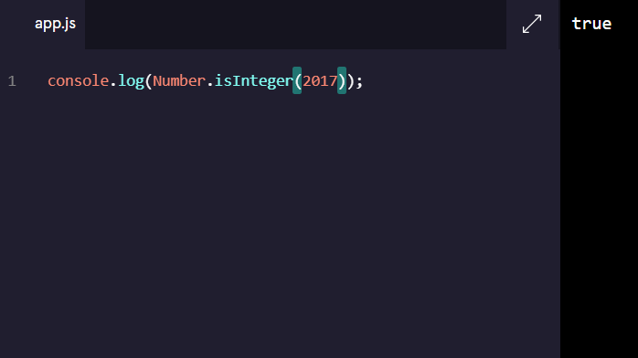

Slide 24

Let’s take one more glance at the concepts we just learned:
Data is printed, or logged, to the console, a panel that displays messages, with console.log().
We can write single-line comments with // and multi-line comments between /* and */.
fundamental data types in JavaScript: strings, numbers, booleans, null, undefined.
Numbers are any number without quotes: 23.8879
Strings are characters wrapped in single or double quotes: 'Sample String'
The built-in arithmetic operators include +, -, *, /, and %.
Objects, including instances of data types, can have properties, stored information. The properties are denoted with a . after the name of the object, for example: 'Hello'.length.
Objects, including instances of data types, can have methods which perform actions. Methods are called by appending the object or instance with a period, the method name, and parentheses. For example: 'hello'.toUpperCase().
We can access properties and methods by using the ., dot operator.
Built-in objects, including Math, are collections of methods and properties that JavaScript provides.

Slide 25
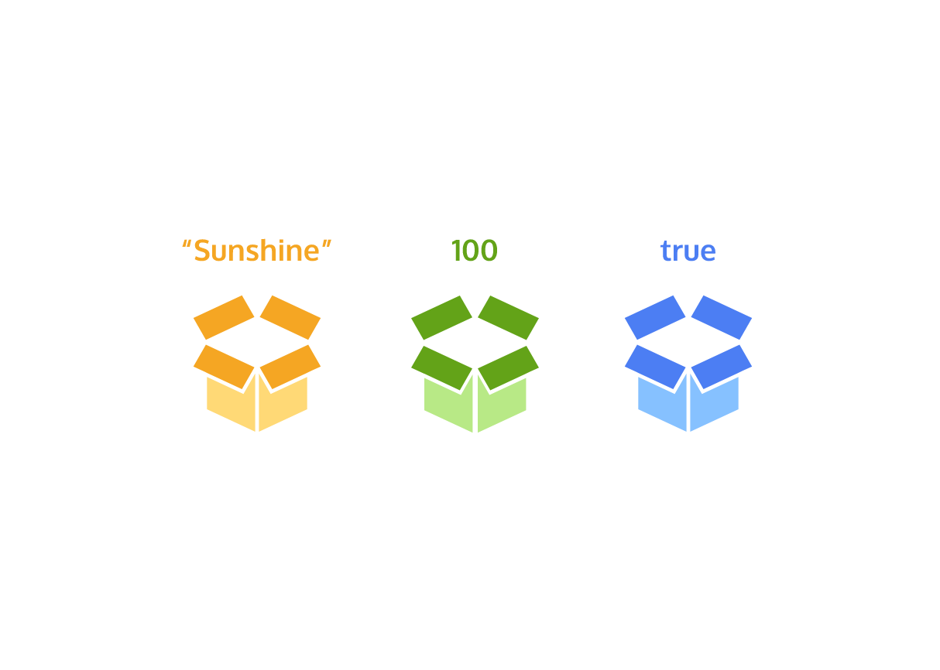
Variables
Notes:
In programming, a variable is a container for a value. You can think of variables as little containers for information that live in a computer’s memory. Information stored in variables, such as a username, account number, or even personalized greeting can then be found in memory.
Variables also provide a way of labeling data with a descriptive name, so our programs can be understood more clearly by the reader and ourselves.

Slide 26
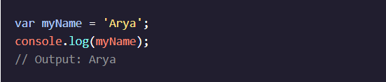
Create a Variable: var
There were a lot of changes introduced in the ES6 version of JavaScript in 2015. One of the biggest changes was two new keywords, let and const, to create, or declare, variables. Prior to the ES6, programmers could only use the var keyword to declare variables.
Notes:
Let’s consider the example above:
var, short for variable, is a JavaScript keyword that creates, or declares, a new variable.
myName is the variable’s name. Capitalizing in this way is a standard convention in JavaScript called camel casing. In camel casing you group words into one, the first word is lowercase, then every word that follows will have its first letter uppercased. (e.g. camelCaseEverything).
= is the assignment operator. It assigns the value ('Arya') to the variable (myName).
'Arya' is the value assigned (=) to the variable myName. You can also say that the myName variable is initialized with a value of 'Arya'.
After the variable is declared, the string value 'Arya' is printed to the console by referencing the variable name: console.log(myName).

Slide 27
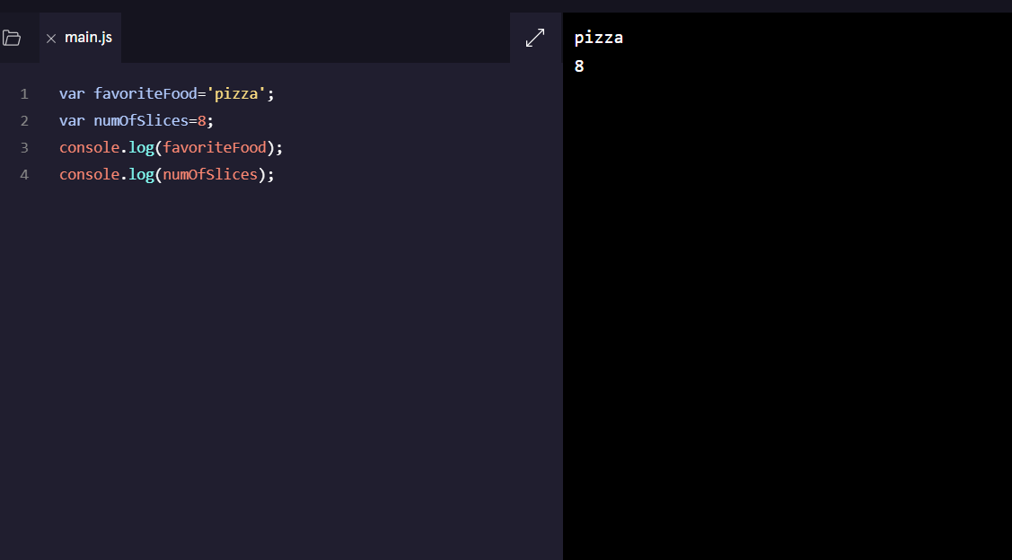

Slide 28
Window alert() Method
alert("Hello! I am an alert box!!");

Slide 29
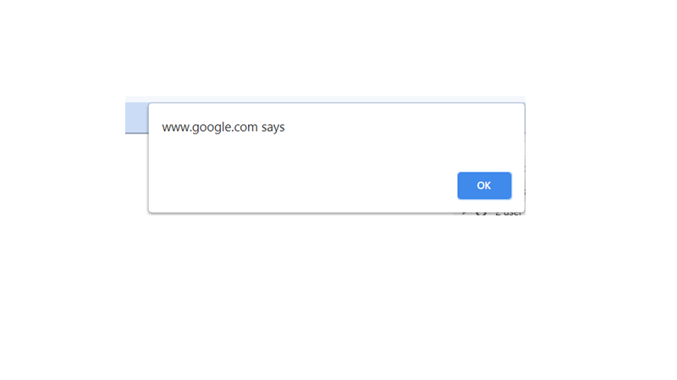

Slide 30
Prompt Box
A prompt box is often used if you want the user to input a value before entering a page.
When a prompt box pops up, the user will have to click either "OK" or "Cancel" to proceed after entering an input value.

Slide 31
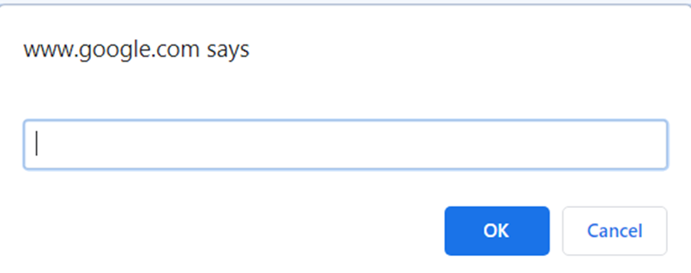

Slide 32
while (condition) { // code block to be executed }
In computer science, a loop is a programming structure that repeats a sequence of instructions until a specific condition is met. Programmers use loops to cycle through values, add sums of numbers, repeat functions, and many other things
LOOPS

Slide 33

GAME

Slide 34

Guess the Number

Slide 35
function guessNumber() {
// generating a random integer from 1 to 10
const random = Math.floor(Math.random() * 10) + 1;
// take input from the user
let number = parseInt(prompt('Guess a number from 1 to 10: '));
// take the input until the guess is correct
while(number !== random) {
number = parseInt(prompt('Guess a number from 1 to 10: '));
}
// check if the guess is correct
if(number == random) {
alert('You guessed the correct number.');
}
}

Slide 36

Thank you:)
LinkedIn-Aniket Artani
aniketartani25@gmail.com

